Slide 1
Course Request selection through Parent Portal

Slide 2
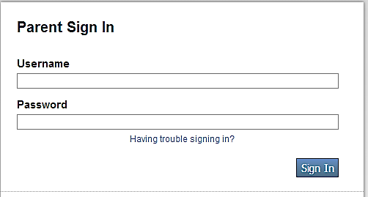
Course Request Selection
Launch the browser (preferred browsers are Firefox or Google Chrome)
Enter this web address: https://sis.henrico.k12.va.us/public
The Parent Sign In screen will appear.
Enter your UserName and Password.
Click Sign In.

Slide 3
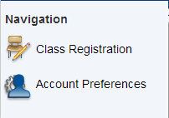
Course Request Selection
Once the Portal page opens, click on the Class Registration icon in the Navigation section on the left. The class registration screen will open.
Please note that parents of Rising 6th grade students (elementary parents) will see two icons ONLY. Parents of current secondary students will see a full range of icons to choose from. If the Class Registration icon is not visible, contact your student’s School Counseling Department.
Check the top of the screen to make sure the correct school name appears. For Rising 6th and 9th grade students, this should be the name of their new middle or high school. All other students should see the name of their current school. If the school name is incorrect, contact your student’s School Counseling Department.

Slide 4
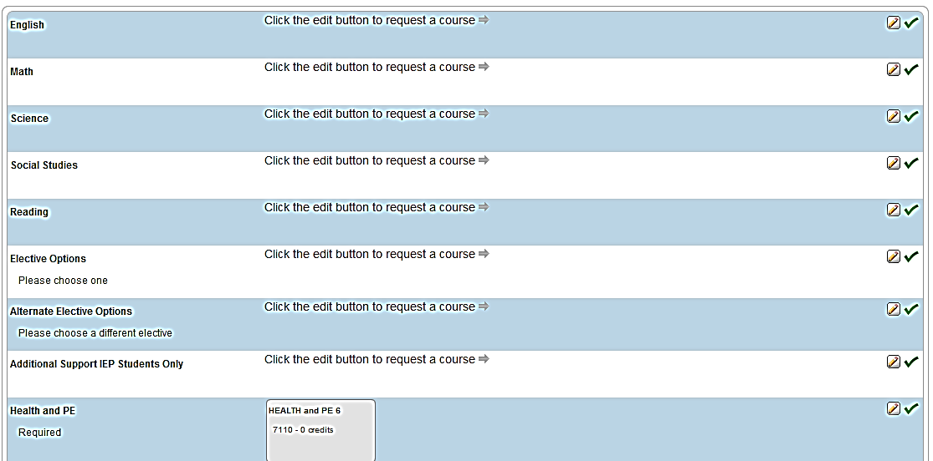
Course Request Selection
Listed on the left side of the class registration screen will be course subject areas. To the right of each subject area, you will see a pencil icon. Before clicking on the pencil, please be sure to read any directions or notes. In some cases, a course may have been pre-selected for your student. To make a course selection, click on the pencil icon.

Slide 5
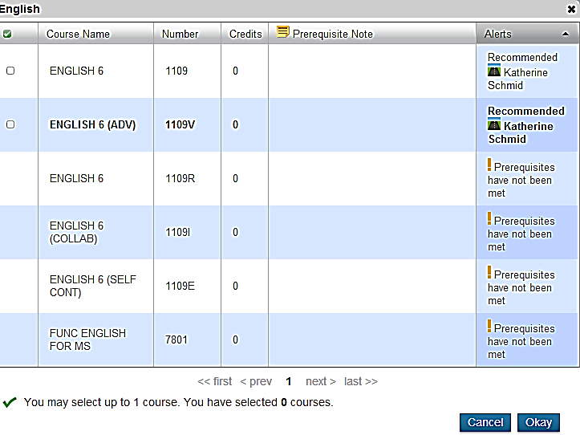
Course Request Selection
Clicking on a pencil icon opens a window showing possible course selections. Core courses (and some electives) require a teacher recommendation in order to be selected. The teacher’s name appears on the right. Select the desired course by clicking in the box to the left. Courses with no check box cannot be selected.
Available for selection because teacher recommendation has been made
Teacher Name
NOTE: Some screens with multiple choices may require you to scroll to “next” to see all course selection possibilities. Be sure to click Okay at the bottom right when you finish.

Slide 6
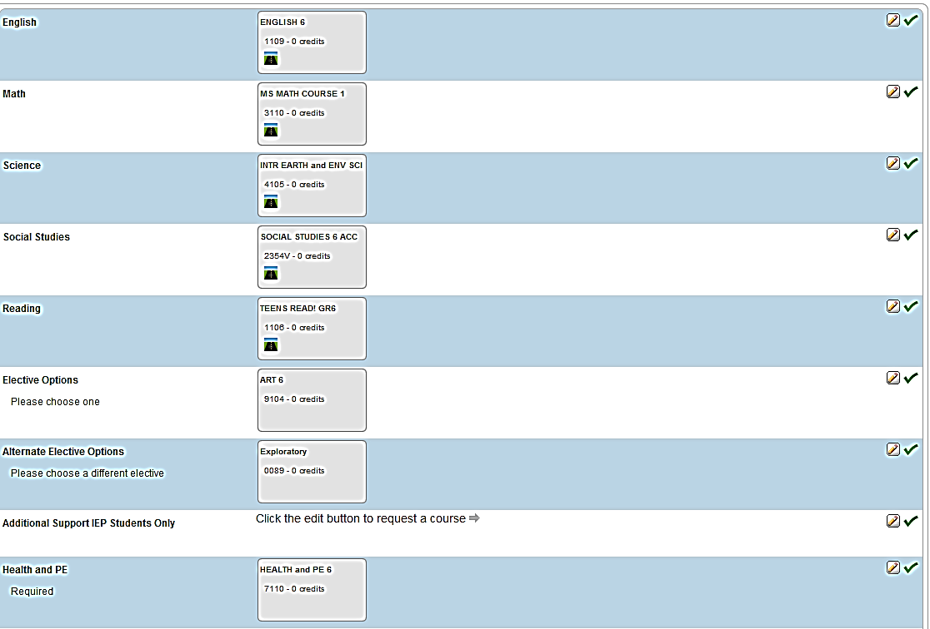
Course Request Selection
When you have completed all course selections, your page will show a “box” on each subject line for which have selected a class.

Slide 7
Course Request Selection
For some elective categories there may be more than one choice necessary. In this case, multiple “boxes” appear on the course subject line and may make the screen more difficult to interpret.
Place your cursor over the pencil icon, and a window will appear indicating the subject area to which that “pencil” is connected.
Click Submit at the bottom of the page when you are sure all selections have been made.

Slide 8
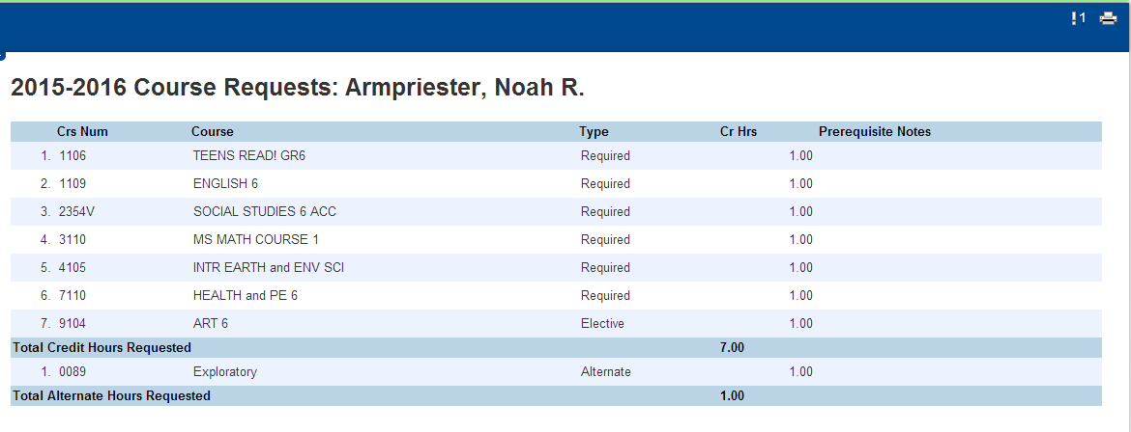
Course Request Selection
After clicking Submit, you will get a message that says “Changes Recorded”. To view a list of your requests, click on the Class Registration icon on the left. This will re-open your course screen. At the top of the course screen, click on the link that says “View course requests”. A list of requests will appear. You may print this page by clicking on the print icon located on the far right end of the Navigation bar.
Student’s Name

