Slide 1
MYP Parent Info Night October 3, 2018
Welcome !
Bienvenue
Bienvenidos
Benvenuto
Willkommen
Huān Ying

Slide 2
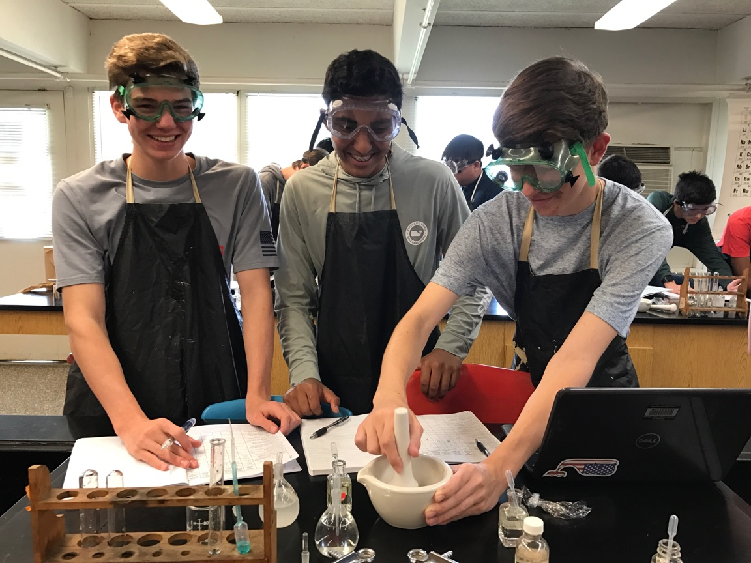
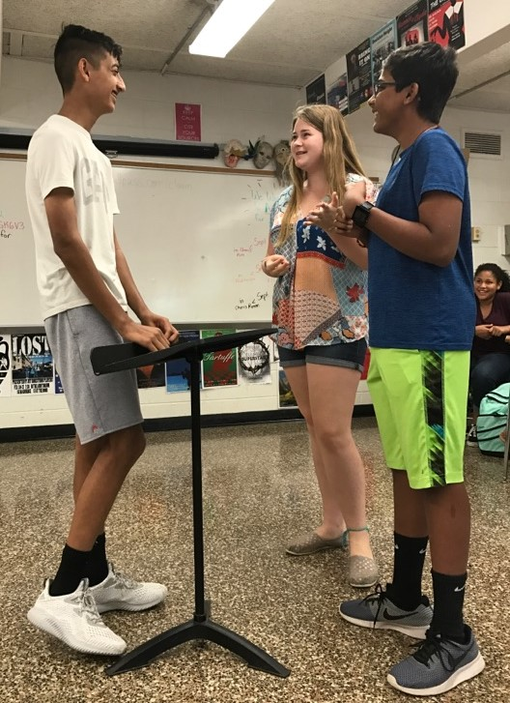
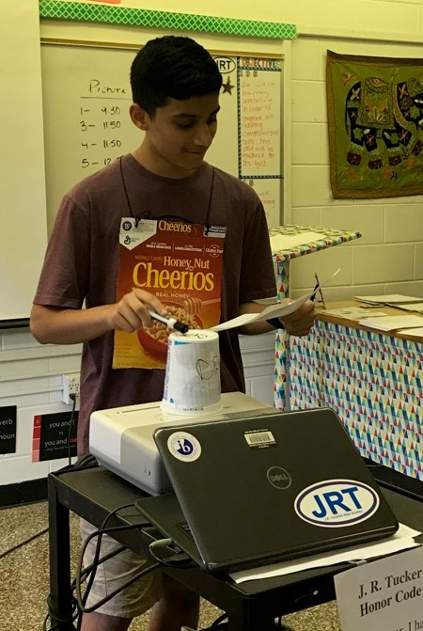
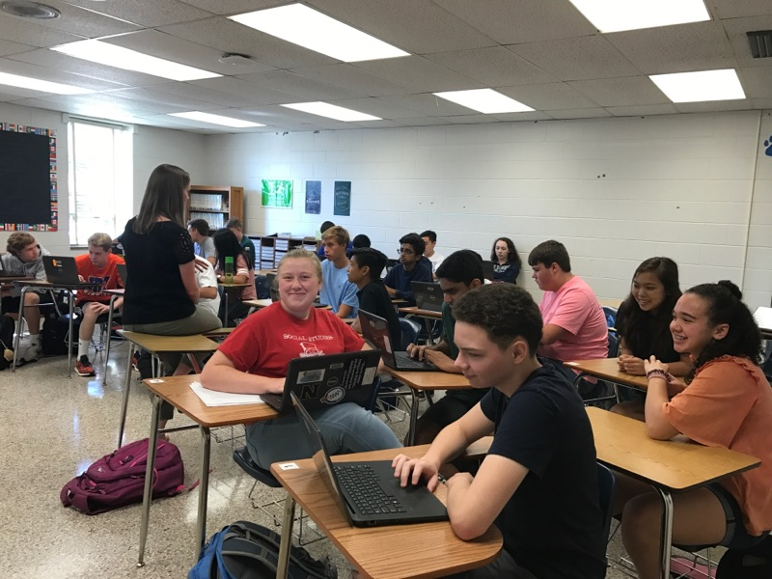
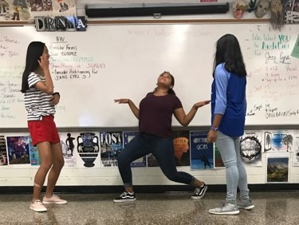

Slide 3
Mission Statement
The International Baccalaureate Organization aims to develop inquiring, knowledgeable, and caring young people who help to create a better and more peaceful world through intercultural understanding and respect. To this end the IBO works with schools, governments, and international organizations to develop challenging programs of international education and rigorous assessment. These programs encourage students across the world to become active, compassionate and lifelong learners who understand that other people, with their differences, can also be right.

Slide 4
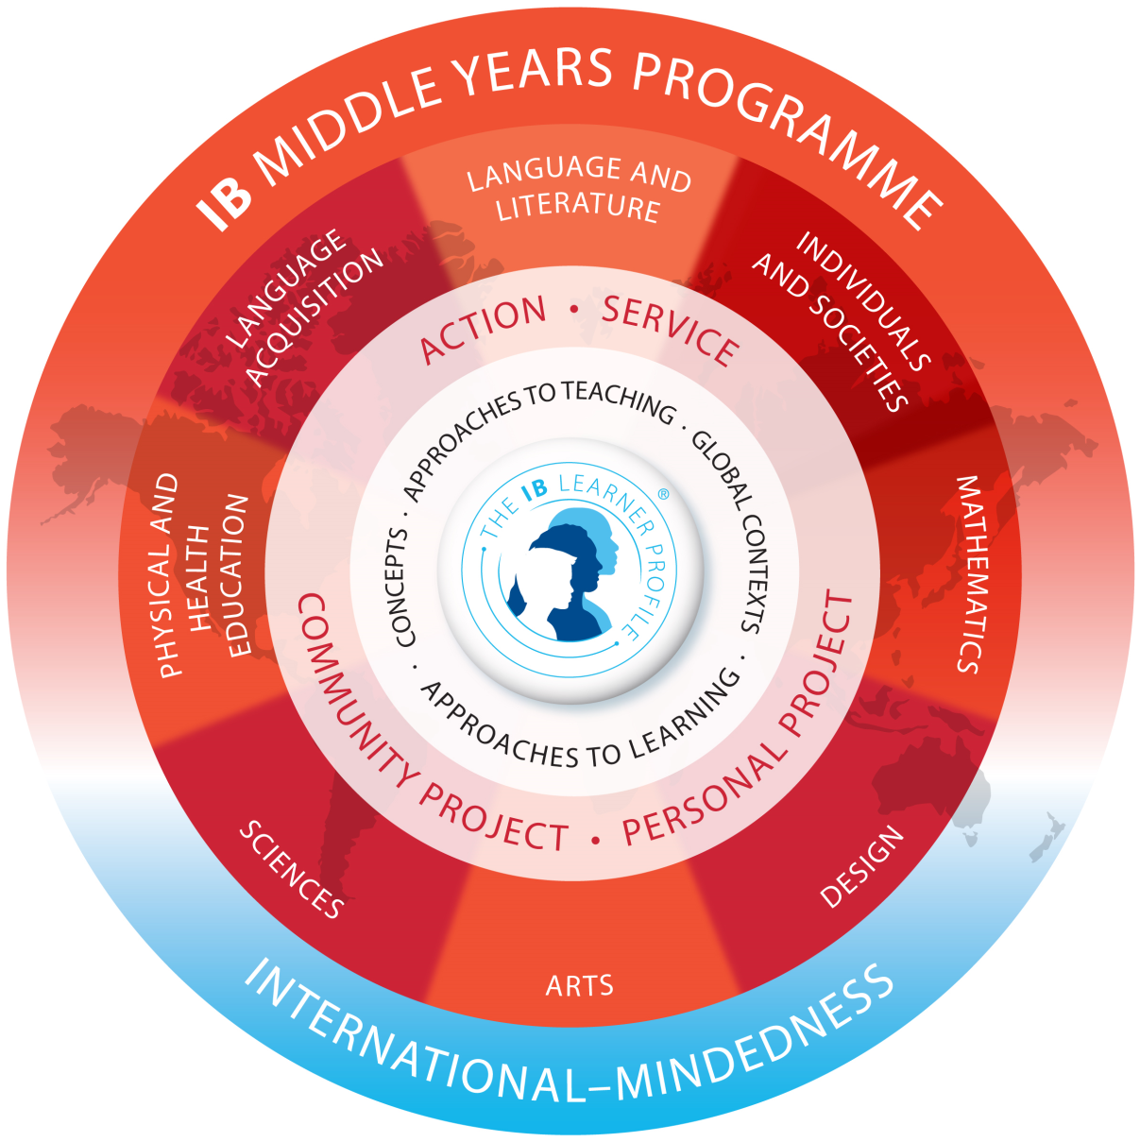
The Program

Slide 5
Creativity, Activity, Service
Harper is the MYP CAS coordinator
Part of IB all four years—makes up the core
Expectations have changed since middle school
ManageBac website to log skill progression and learning
Involvement is student-selected and goal-oriented
Independent work, but could be
collaborative as well
HCPS Community Service

Slide 6
IB CAS
HCPS Community Service
Not just service
Goal-oriented and focused
No counting of hours
ManageBac to document progress
Support from Mrs. Harper
IB CAS website
Only service
Random sampling of activities
Track hours
CS paper logs
Support from SS teacher / contact Ms. Wesson (dwesson)
HCPS Community Service website

Slide 7
Personal Project
Support is provided through seminar and English 9 & 10 class
Freshmen begin in March, major progress made over summer, paper due the following December
Freshman parent meeting in spring 2019
Sophomores: Final paper due December 3, 2018
Required for the MYP and to continue to DP
Must earn a score of 3 (out of 7) to “pass”

Slide 8
MYP Curriculum
Grade 9
Grade 10
Lang. & Lit: MYP English 9
Language Acquisition--MYP French or MYP Spanish
Mathematics—MYP Geometry or MYP Algebra 2
Sciences—MYP Biology
Ind. & Societies—MYP World History & Geography 2
Arts—MYP Drama or MYP Visual Art
Health & Physical Education—MYP PE 9
Lang. & Lit.: MYP English 10
Language Acquisition—MYP French or MYP Spanish
Mathematics—MYP Algebra 2 or MYP Extended Math
Sciences—MYP Chemistry
Ind. & Societies—MYP US/VA Government
Arts—MYP Drama or MYP Visual Art
Health & Physical Education—MYP PE 10

Slide 9
MYP Assessment Scores
MYP scores posted in PowerSchool to show progress. **4/8 MYP score is NOT failing
Access to IB rubrics is provided by teachers
What are the red flags?
Final score calculated for subject based on work submitted from September-June
Certificate of Achievement & Certificate of Participation

Slide 10
Final grade of 1-7 per subject
Lang. & Lit + Language Acquisition + Mathematics + Sciences + Ind. & Societies + Arts + Health & Physical Education + Personal Project = _____ / 56

Slide 11
Seminar
Mondays
Coordinator-led lessons designed around the Learner Profile (LP)
Pass/fail—see curriculum on seminar page
Instruction on a variety of topics including: “All About IB,” Approaches To Learning, diversity and acceptance, time management
Discussions, documentaries, guest speakers
Assignments graded and recorded in different courses

Slide 12
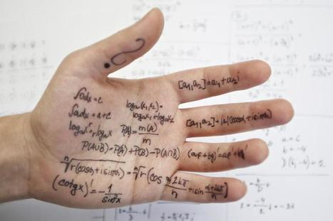
Academic Honesty
Notes:
Image taken from website www.scoop.it Articles on Academic Honesty in Higher Ed http://img.scoop.it/kYz_v9BKk_ha5ZbFA1j3qDl72eJkfbmt4t8yenImKBVvK0kTmF0xjctABnaLJIm9

Slide 14
Tips for Success
Get to bed ARTICLE
PowerSchool grades—don’t obsess
Redefine success
Be open to changing strategies
Ask questions
Reach out at the onset of a problem
Encourage school spirit, involvement in sports and clubs

Slide 15
GRRRRIT
Notes:
Failure is not fatal, fixed mindset vs. flexible thinking, intrinsic motivation leads to learning for the long-term, enjoyment of the task itself, emphasis on personal growth (developing new skills through practice), exceed your own personal standard not THE standard

Slide 16
“Success is not final, failure is not fatal. It is the courage to continue that counts.” Winston Churchill

Slide 17
Miscellaneous
The Library is open before school for students at 8:15
AE is Tuesday-Friday; 40 minutes to study, do homework, get extra help, attend club meetings
Teachers and NHS tutors available for extra help
IB Office is always open to students
IB Advisory Council 11/13, 2/26, 4/30

Slide 18
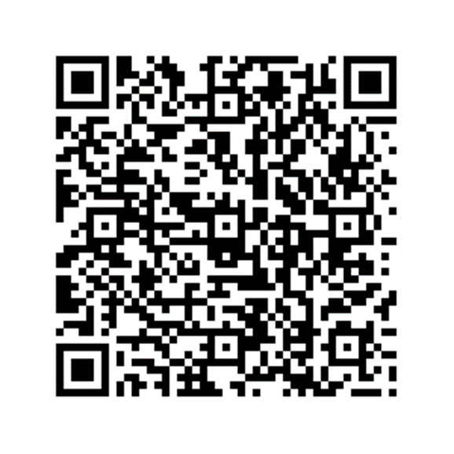
Merci Gracias Grazie
DANKESCHÖN

