Slide 1
PowerSchool and Course Selections The Parent Experience
Making Online Course Selections for the Next School Year

Slide 2
Steps for completing course requests
Parents must login to PowerSchool Parent Portal and create an account.
Parents will not have access until the parent window, which is February 5-16. Starting the 17th, you will no longer have access.
Website address for Portal: https://sis.henrico.k12.va.us/public/home.html
The following information will be required in order to complete your account creation:
You must have an email address for setup
You will be required to setup a password
Child’s name (First Name, Last Name)
Student ID, which is Access ID in PowerSchool (If you do not have your child’s student id, please look at any personal documents from the school that may contain that information or you will need to visit your child’s school to obtain that information)
Student DOB, which is Access Password in PowerSchool (Format - YYYYMMDD)

Slide 3
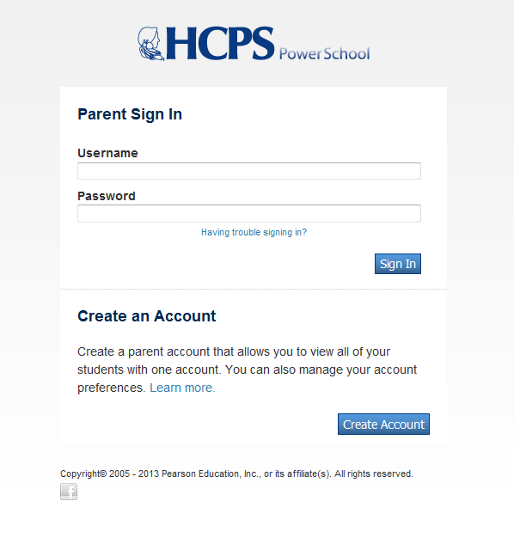
Sample account creation
First step is to Create an Account
Click once on the “Create Account” button.
This will activate the setup screen.

Slide 4
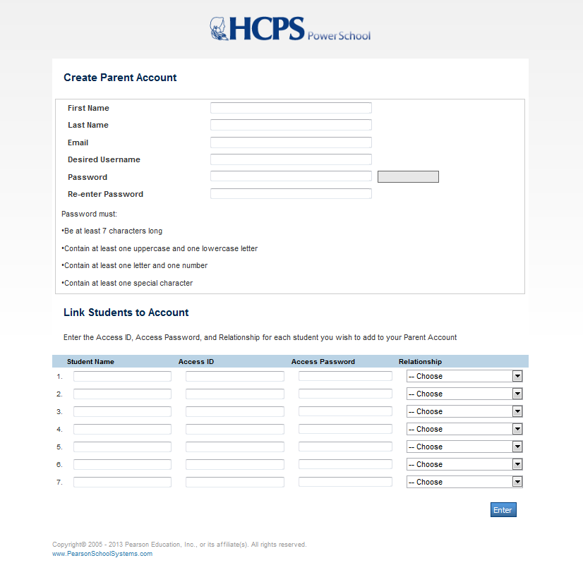
Create parent account
Second step is to complete the account setup process
Must enter the following information in the top half of the screen:
Parent first name
Parent last name
Email address
Desired username
Password and re-entry
Must follow guidelines for creating a password.
Example: M%d0g1987

Slide 5
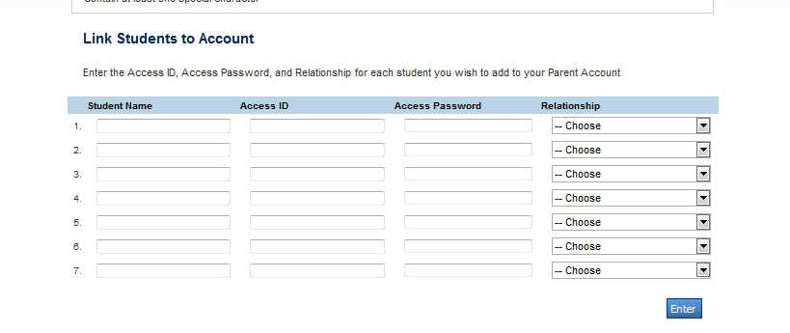
Link students to account
Third step is to complete the “Link Students to Account” process
Must enter the following information:
Student name (first name last name)
Access ID which is Student ID
Access Password which is DOB (Format - yyyymmdd)
Select your relationship with the student from the dropdown list
Click once on the Enter button.

Slide 6
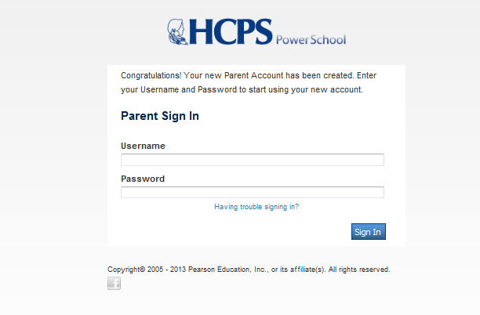
Successful Setup!
You know you have successfully setup your parent account when you receive the following screen.

Slide 7
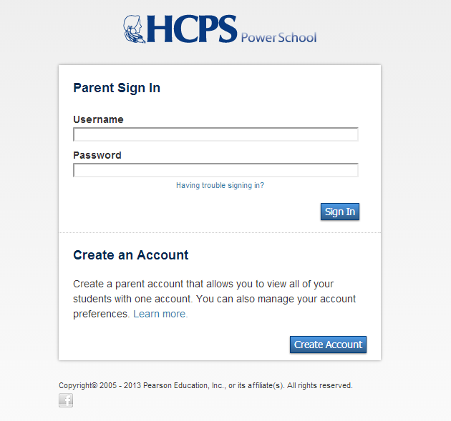
Login to parent portal
Enter the user id and password that you created during setup to access your student’s screen.

Slide 8
Class Registration
Click on the Class Registration Icon located on the left.
This will reveal the student screen and access to make selections.

Slide 9
More than one student
If you have more than one student to complete, you will see the student names listed at the top left of the screen.
Simply click on the student you wish to work with and the screen will refresh.

Slide 10
How to make selections
The course selection screen contains all possible options for next year courses to include core and elective courses.
When selecting core courses, teachers have made the appropriate recommendation based on criteria. Click once on the pencil to make the selection.

Slide 11
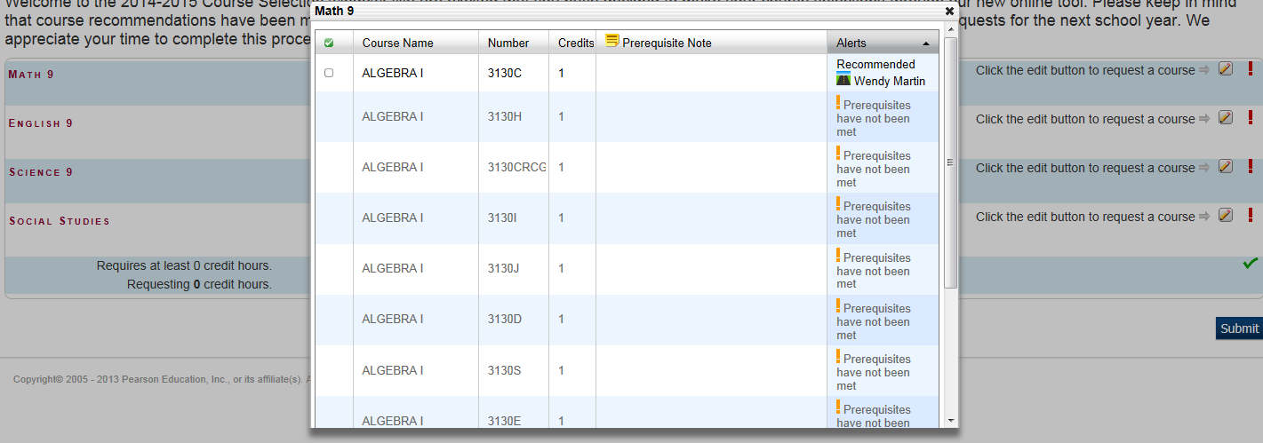
Making selections continued
When you click on the pencil, the possible selections appear.
As a reminder, core courses require a teacher recommendation in order for you to be able to make that selection.
You must click once on the “Okay” button for each request.

Slide 12
Completing recommendations
Once you are done, click once on the submit button.
Note: Green checkmarks represent work is done.

Slide 13
View Requests
Once you have submitted the selections, you can view the students requests.
These can be printed by clicking on the “Print” icon located at the top right section of the window.
2018 – 2019 Course Requests

