Slide 1
Green Screen Project
By: Vibha Shekhar and Radha Kapadia

Slide 2
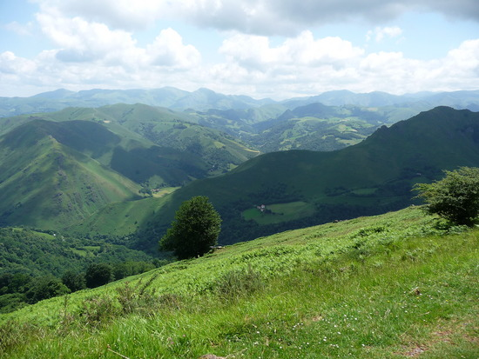

Slide 3
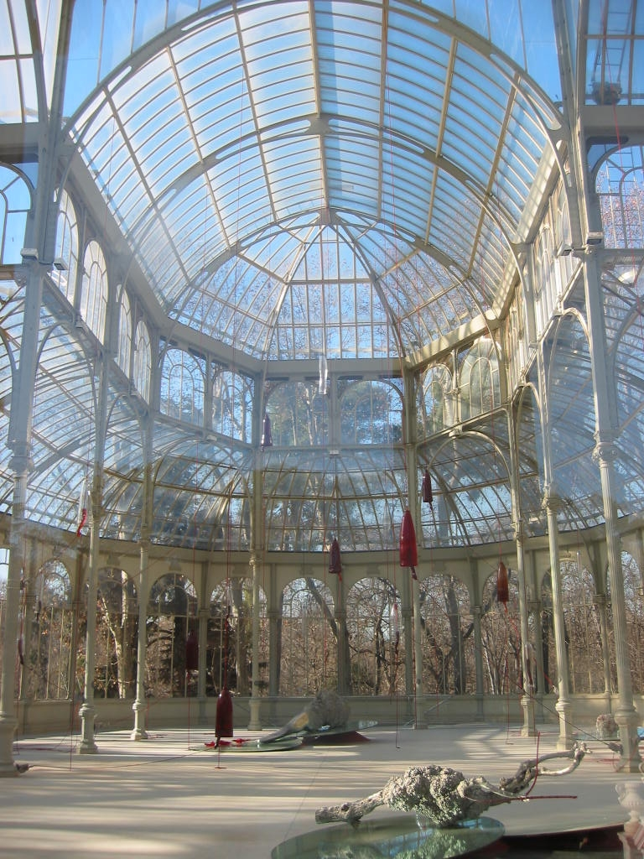

Slide 4
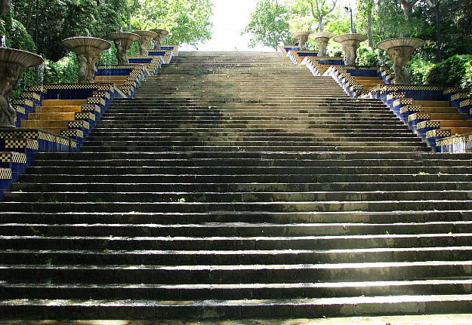

Slide 5
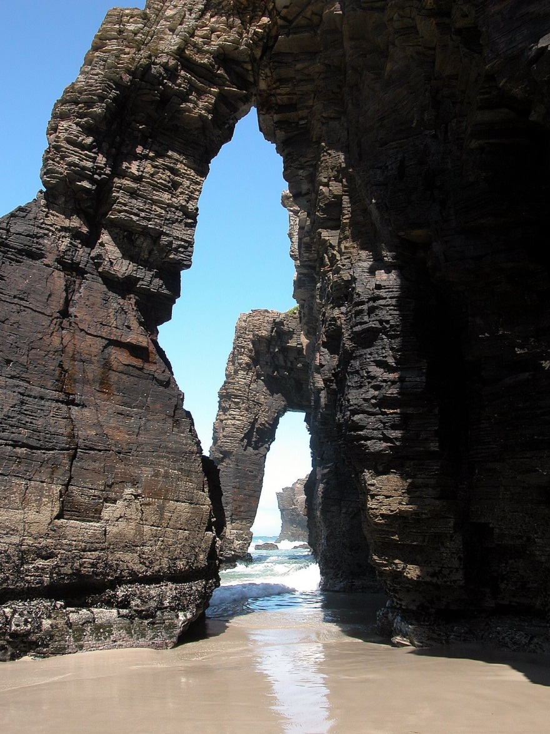

Slide 6
