Slide 1
MYP Parent Info Night October 17, 2017
Welcome !
Bienvenue
Bienvenidos
Benvenuto
Willkommen
Huān Ying

Slide 2
Mission Statement
The International Baccalaureate Organization aims to develop inquiring, knowledgeable, and caring young people who help to create a better and more peaceful world through intercultural understanding and respect. To this end the IBO works with schools, governments, and international organizations to develop challenging programs of international education and rigorous assessment. These programs encourage students across the world to become active, compassionate and lifelong learners who understand that other people, with their differences, can also be right.

Slide 3
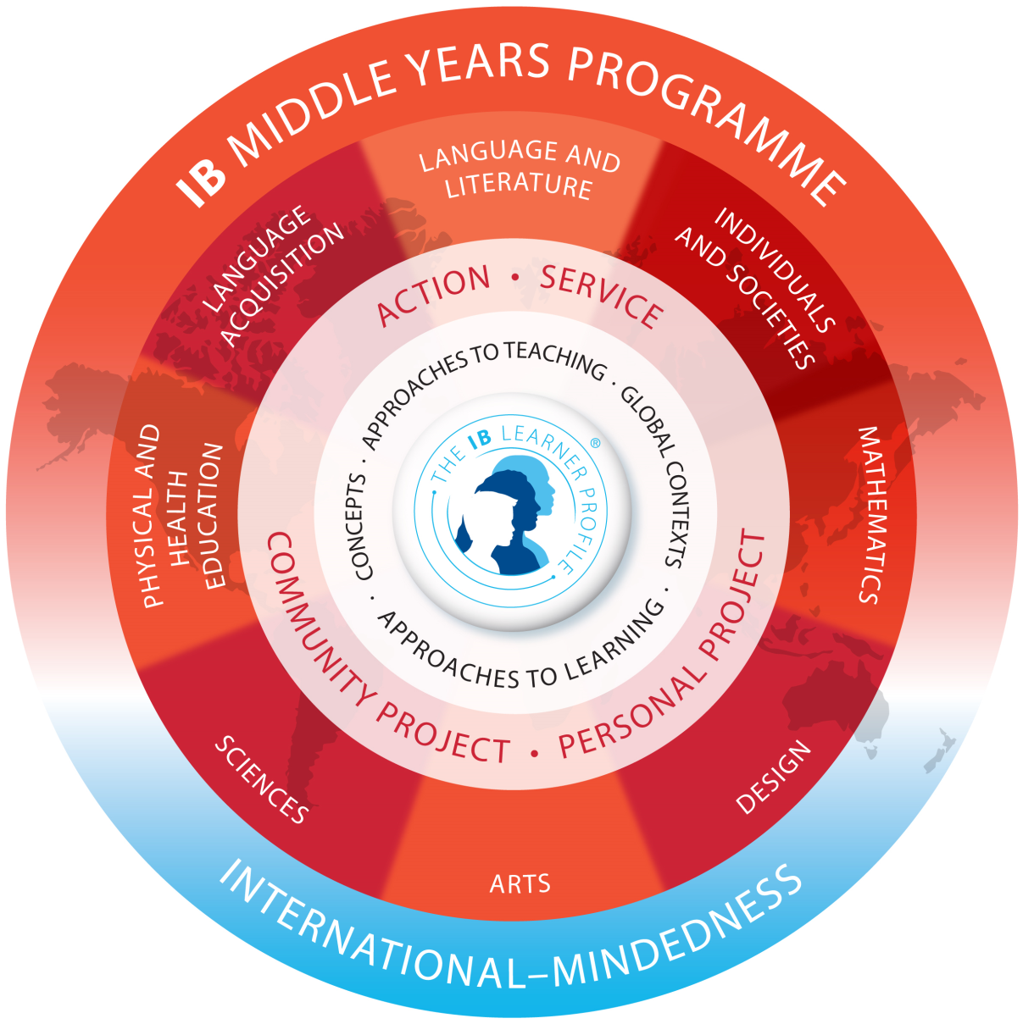
The Program

Slide 4
MYP Curriculum
Grade 9
Grade 10
Lang. & Lit: English 9
Language Acquisition--MYP French or MYP Spanish
Mathematics—MYP Geometry or MYP Algebra 2
Sciences—MYP Biology
Ind. & Societies—MYP World History & Geography 2
Arts—MYP Drama or MYP Visual Art
Health & Physical Education—MYP PE 9
Lang. & Lit.: English 10
Language Acquisition—MYP French or MYP Spanish
Mathematics—MYP Algebra 2 or MYP Extended Math
Sciences—MYP Chemistry
Ind. & Societies—MYP US/VA Government
Arts—MYP Drama or MYP Visual Art
Health & Physical Education—MYP PE 10

Slide 5
Creativity, Activity, Service
Harper is the MYP CAS coordinator
Requirement in all four years of IB
Expectations have changed since middle school
ManageBac subscription to log progress
Involvement is student-selected and goal-oriented
Document participation and learning regularly through MB
Independent work, but could be
collaborative as well
HCPS Community Service

Slide 6
Personal Project
Mrs. Cuccherini is coordinator
Support is provided through seminar and English class
Freshmen begin in March, major progress made over summer, due the following December
Freshman parent meeting in March 2018
Sophomores: Final paper due December 11, 2017
Required for the MYP and to continue to DP
Must earn a score of 3 (out of 7) to “pass”

Slide 7
MYP Assessment Scores
MYP scores posted to show progress, does not affect HCPS grade. FYI only- 4/8 MYP score is NOT failing
Access to IB rubrics is provided by teachers
Teachers calculate final score for their subject based on work from September-June with the use of grade boundaries
Student will earn a final grade of 1-7 in each of their 7 courses plus Personal Project
Certificate of Achievement & Certificate of Participation
Encourage student to seek out help at the onset of a problem
Teachers available for extra help by appointment; free tutoring by NHS
What are the red flags?

Slide 8
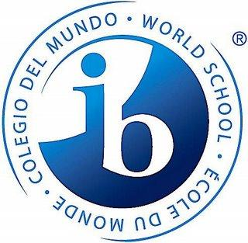
Diploma Program (11-12)
Admission
Beginning in February, sophomores will learn more about DP courses
Course selection finalized in February
DP parent meetings offered each fall

Slide 9
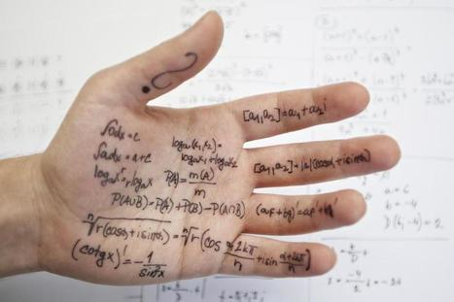
Academic Honesty
Notes:
Policy is posted on IB site, turnitin.com, authentic work, malpractice and collusion, consequences, honor pledge
Image taken from website www.scoop.it Articles on Academic Honesty in Higher Ed http://img.scoop.it/kYz_v9BKk_ha5ZbFA1j3qDl72eJkfbmt4t8yenImKBVvK0kTmF0xjctABnaLJIm9

Slide 11
Seminar
Mondays on a rotating schedule
Coordinator-led lessons designed around the LP
Instruction on a variety of topics including: “All About IB,” ATL, diversity and acceptance, time management
Some assignments graded and recorded in different courses

Slide 12
Miscellaneous
The Library is open before/after school for students at 8:15
AE is Tuesday-Friday; 40 minutes to study, do homework, get extra help, attend club meetings
Involvement in sports and clubs
Quiet study time at home
Classroom distractions
All About IB booklets and MYP General Regulations available on JRT IB website
IB Advisory Council 11/15, 1/30, 4/17

Slide 13
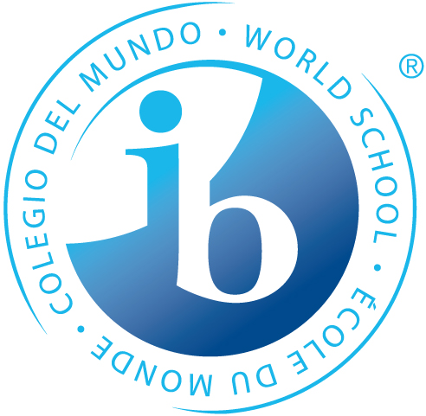
Merci Gracias Grazie
DANKESCHÖN

