Slide 1

WELCOME CLASS OF 2023!
J.R. Tucker High School IB Programme
Ellie Harper, IB Coordinator

Slide 2

Tonight’s agenda
  IB Program overview
  Hear from IB students
  Review packet

Slide 3


Our mission
The International Baccalaureate Program at J.R. Tucker High School aims to develop inquiring, knowledgeable and caring young people who become lifelong learners.
The IB curriculum is a holistic approach to learning that focuses on the student’s intellectual and social development.
Connections between subjects, classroom learning and the real world help students learn the art of collaboration as well as develop intercultural awareness and understanding.

Slide 4
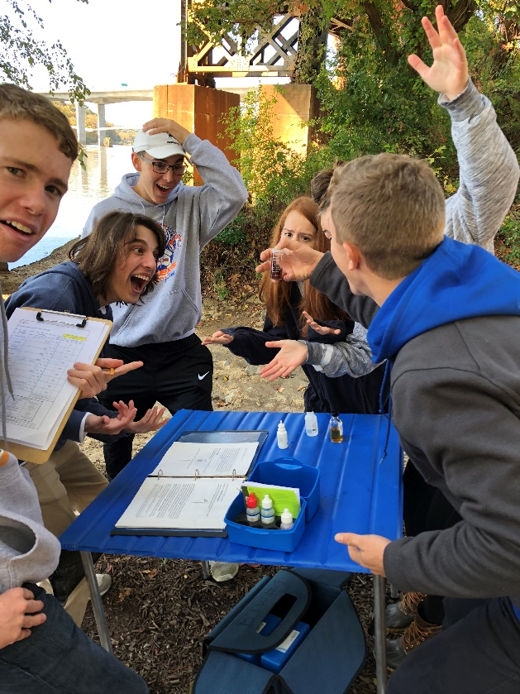
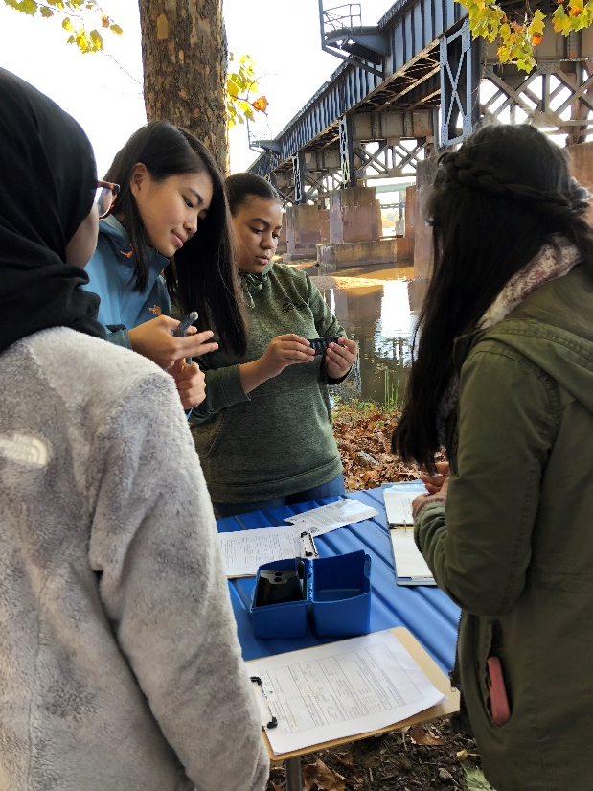
What is the profile of the
IB Learner?
The attributes of the IB Learner Profile express the philosophy and values of the IB educational program.
The IB program promotes the education of the whole person, emphasizing intellectual, personal, emotional and social growth through all areas of knowledge.

Slide 5
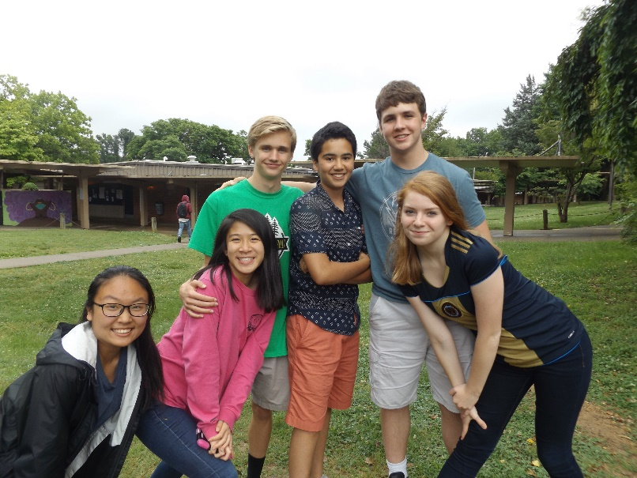
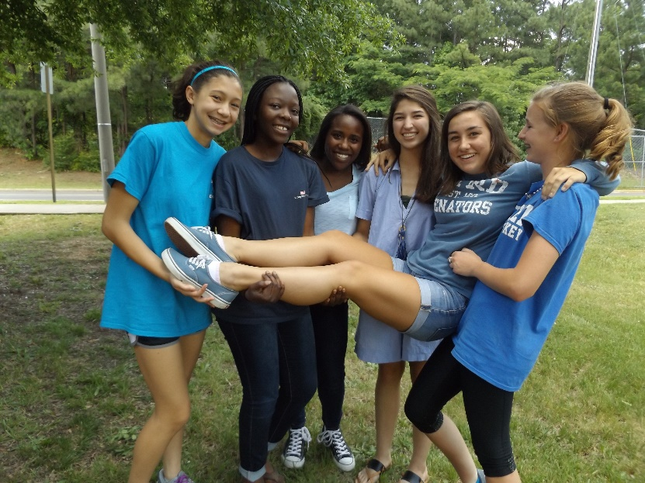
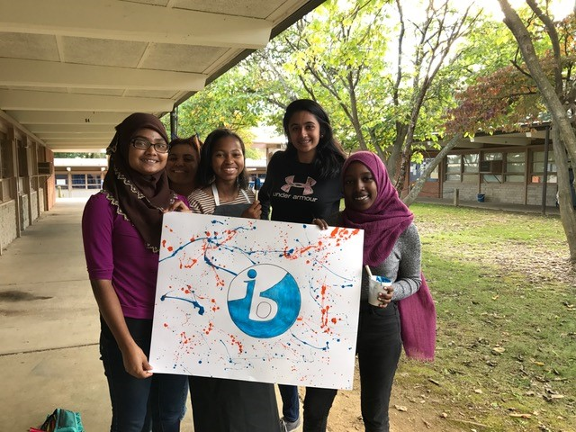
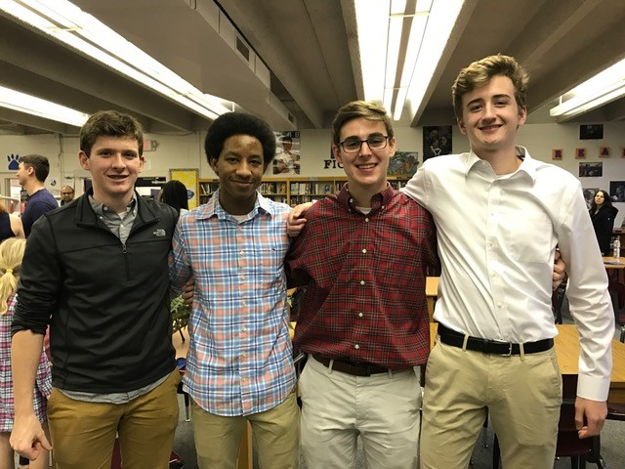
IB learners strive to be…
  Inquirers
  Knowledgeable
  Thinkers
  Communicators
  Principled
  Open-Minded
  Caring
  Risk-Takers
  Balanced
  Reflective

Slide 6
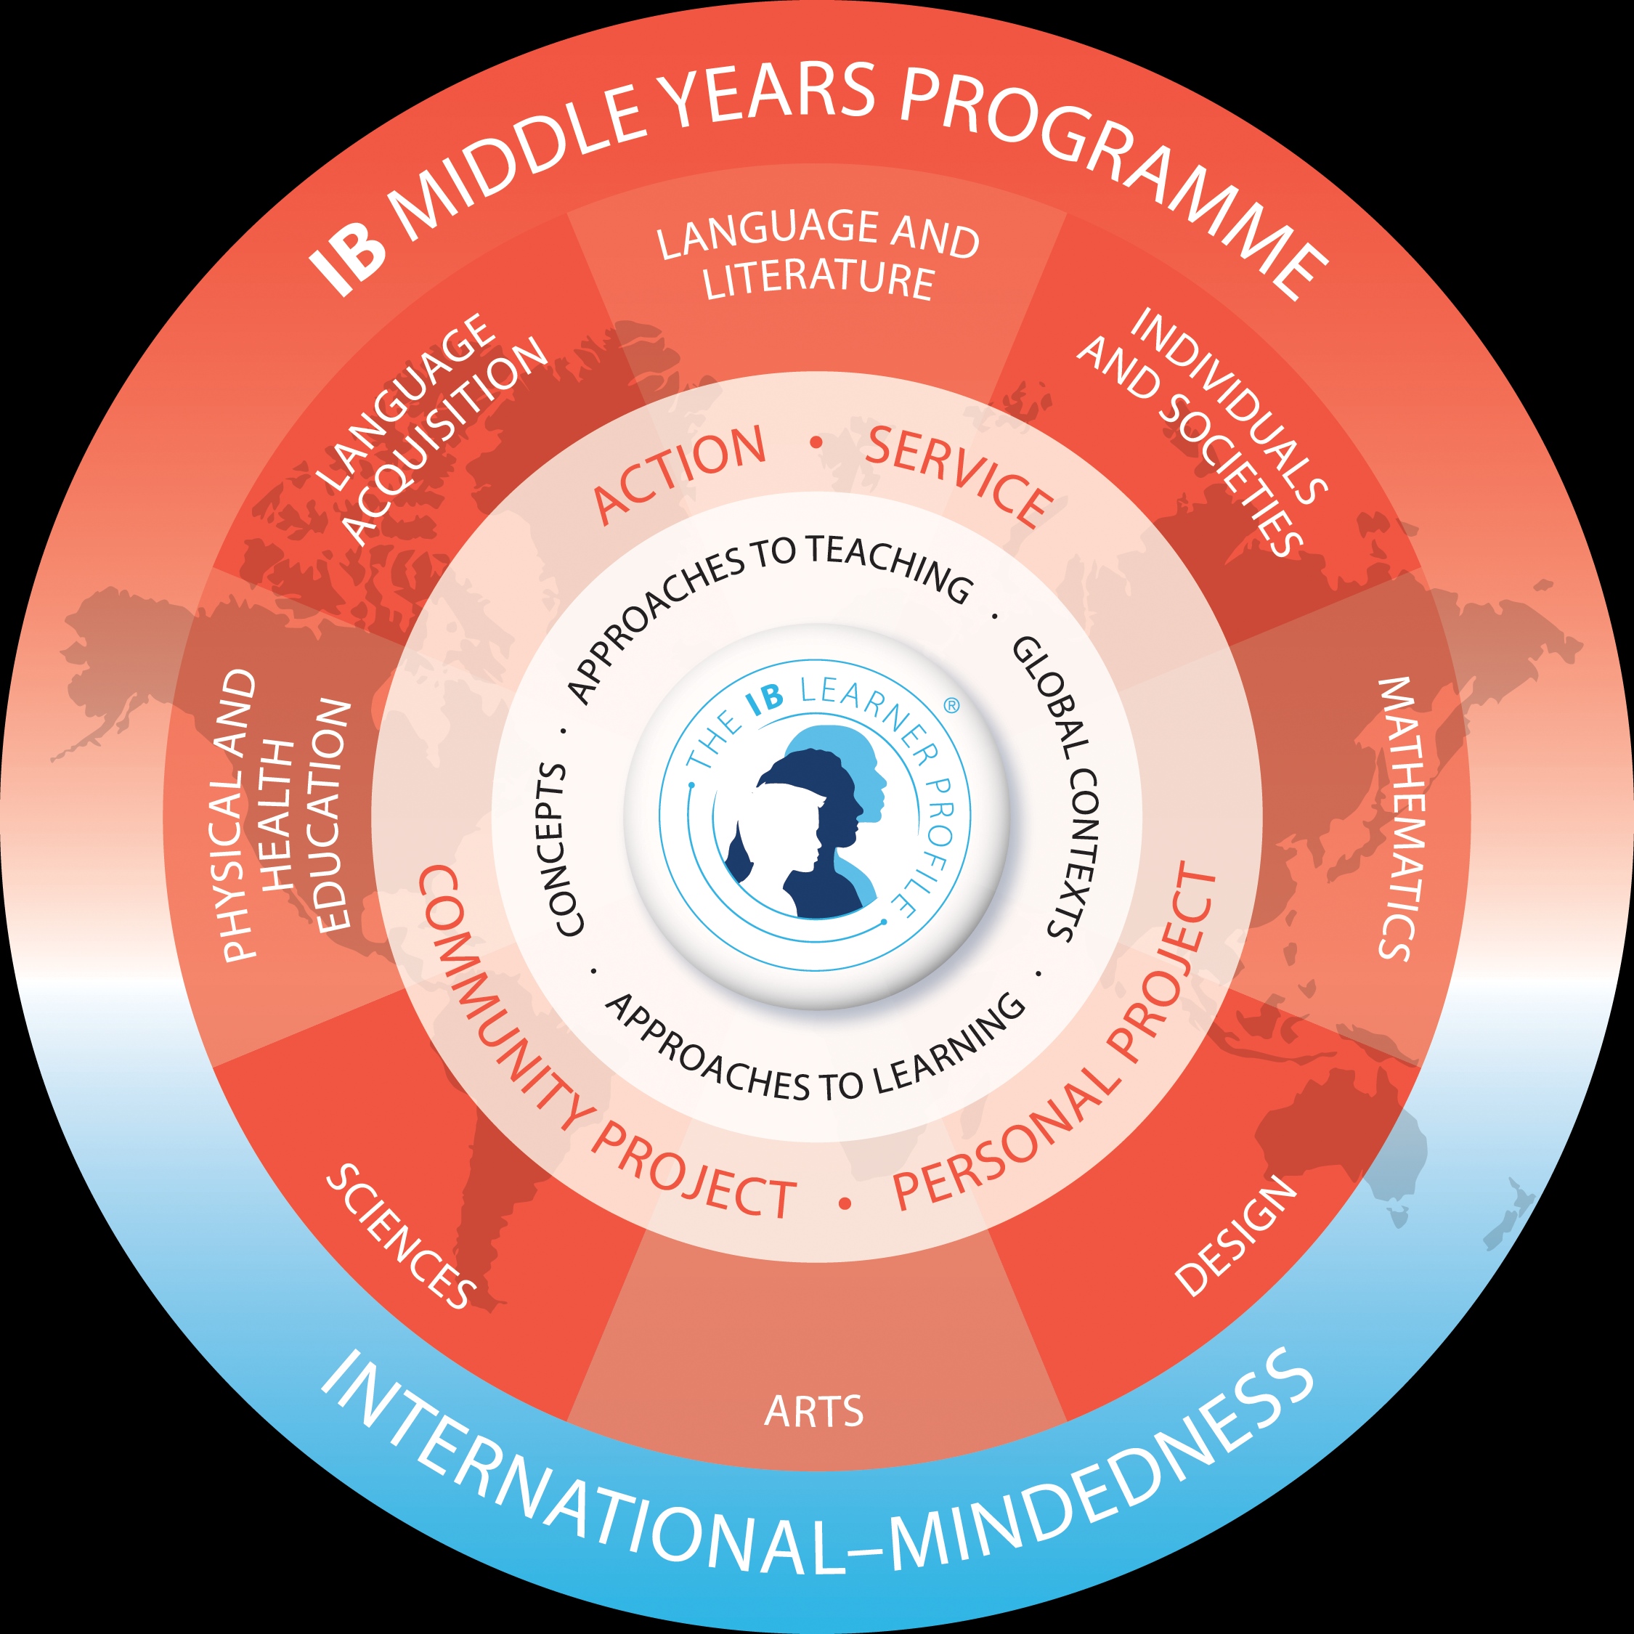
THE MIDDLE YEARS PROGRAM
Grades 6 to 10

Slide 7
MYP Courses
Subject | Course
Language & Literature | English 9, English 10
Language Acquisition | French, Spanish
Individuals & Societies | World History & Geog. 2 US/VA Government
Mathematics | Geometry, Alg. 2, Extended Math
Sciences | Biology, Chemistry
Arts* | Visual or Performing
Health and Physical Education** | PE 9, PE 10

Slide 8
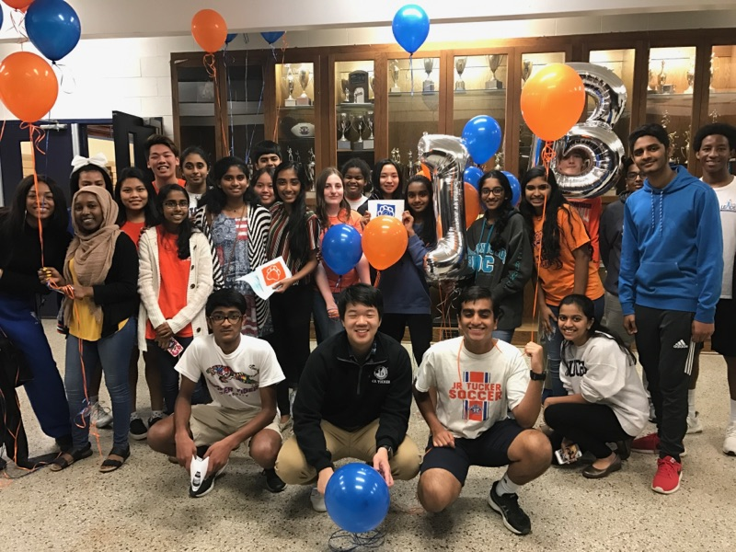

IB AT JRT
We teach the “whole” child
Our IB students learn how to learn – to think, to ask “why,” to analyze, to solve problems
We emphasize teamwork, collaboration and communication skills
Our IB students are involved in everything – sports, cultural arts, government, social activities, the community
Students learn to appreciate diversity – of cultures, ethnicities and backgrounds
We prepare children to be successful in college and in their professions. Our goal is to encourage lifelong learning.
We have a dedicated staff , and we will come to know all of our IB students
Our aim is to partner with parents in
developing young people who will take
thoughtful action in their lives.

Slide 9
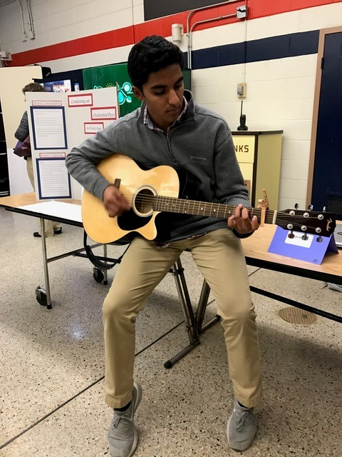
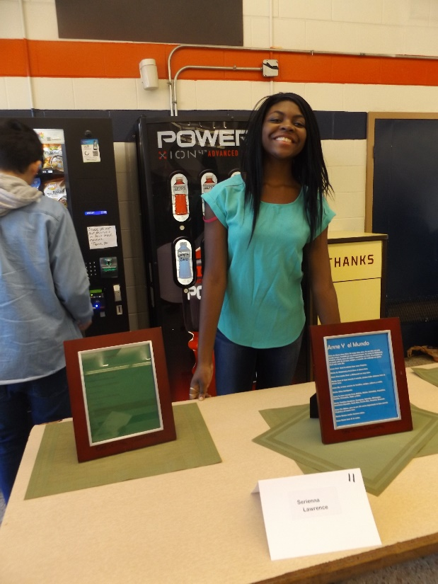
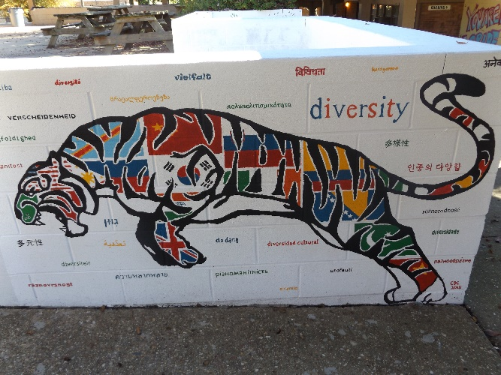
The Personal Project
In grade 10 students complete a personal project. This can take various forms, for example:
an essay
a piece of creative writing
an original science experiment
the organization of an event
The work must :
- be completely independent
- focus on one Global Context
-focus on the process of completing the project
as well as the finished product .

Slide 10
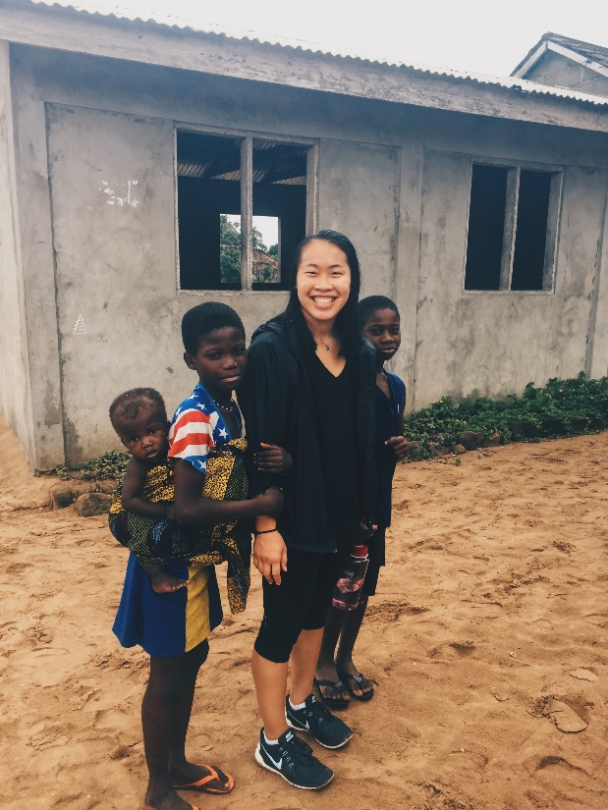
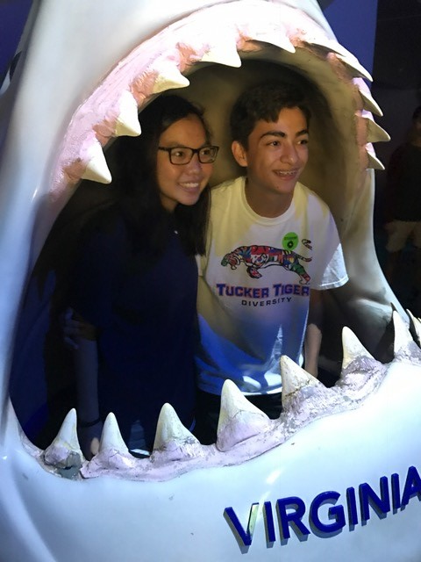
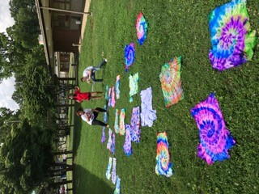
Creativity, Activity, Service
At the core of IB all four years
Goal-oriented, no logging hours
HCPS community service

Slide 11
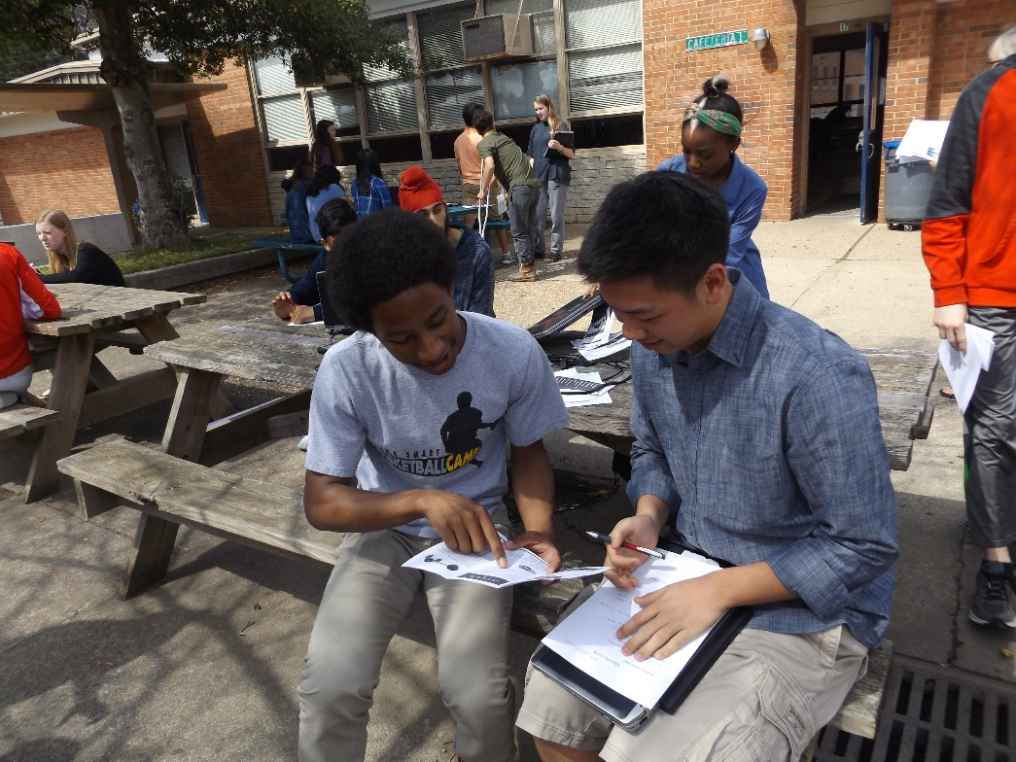
ASSESSMENT IN THE MYP
Teachers organize continuous and varied assessment over the course of the Middle Years Program.
The assessment tasks give students the opportunity to demonstrate achievement according to the required objectives within each subject group. This can include:
open-ended, problem-solving activities
organized debates
hands-on experimentation
analysis
reflection

Slide 12
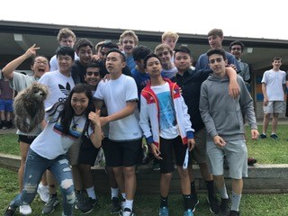
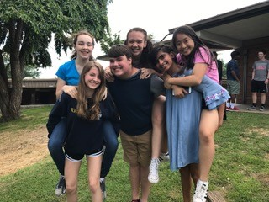
Straight talk from IBers
Tiger Camp
First week of school
Bus rides/hub
Lunch
lockers
Making friends
Clubs and sports
Attend sporting events
Workload

Slide 13
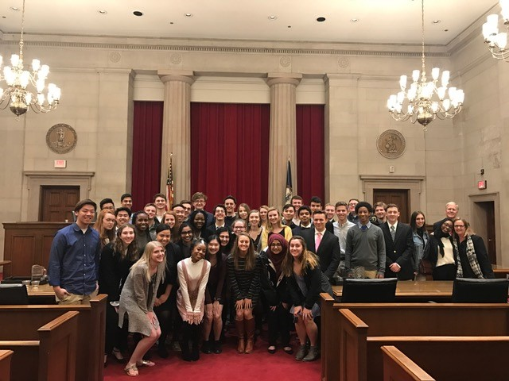
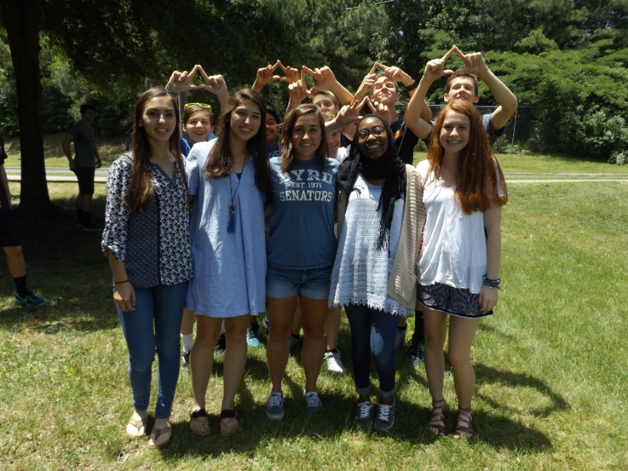

Seminar
Mondays
Program information, lessons designed around the LP, guest speakers, films and discussions
Support of PP, EE, CAS
Occasional HW assignment

Slide 14

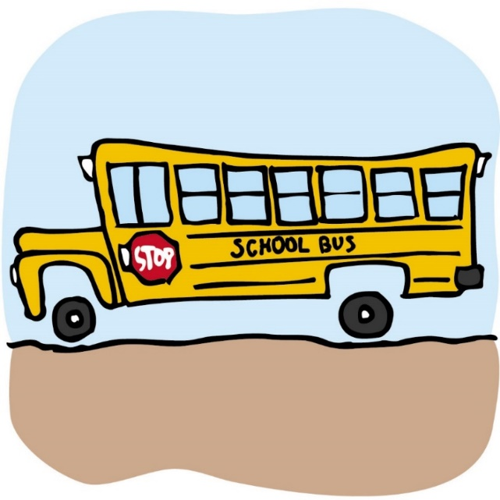
Transportation
Transportation forms have been mailed.
Contact Transportation Office with any questions.

Slide 15
Parent communication & Involvement
Emails sent home regularly to keep you apprised of happenings at JRT
Attend parent meetings
Go to IB link on Tucker website www.tinyurl.com/ibtucker and www.ibo.org
Need volunteers for committees, chaperones, PTSO etc.
Any IB-related question or concern, contact Mrs. Harper

Slide 16

Important dates & events
Tiger Camp date TBD (August) Fee Day/Night
First day of school! September 3
MYP meeting in the fall
First IB breakfast of the year, 10/4

Slide 17
Your packet
Supply list & summer reading
Orange contact information card
Clubs & sports list
MYP General Regulations
IB Class of 2019 college info
PTSO welcome letter
Optional summer enrichment (online)

Slide 18

Thank you for coming!
emharper@henrico.k12.va.us
www.tinyurl.com/ibtucker
www.ibo.org

