Slide 1
Specialty Center Information Sessions 2018 Priscilla Biddle, IB Director at Henrico HS Ellie Harper, IB Director at JR Tucker HS April Craver, IB Programs Specialist

Slide 2
What is IB?
International Baccalaureate is a global academic program that
aims to develop inquiring, knowledgeable and caring young people who help to create a better and more peaceful world through intercultural understanding and respect.
works with schools, governments and international organizations to develop challenging programs of international education and rigorous assessment.
encourages students across the world to become active, compassionate and lifelong learners who understand that other people, with their differences, can also be right.

Slide 3
IB Unique

Slide 4
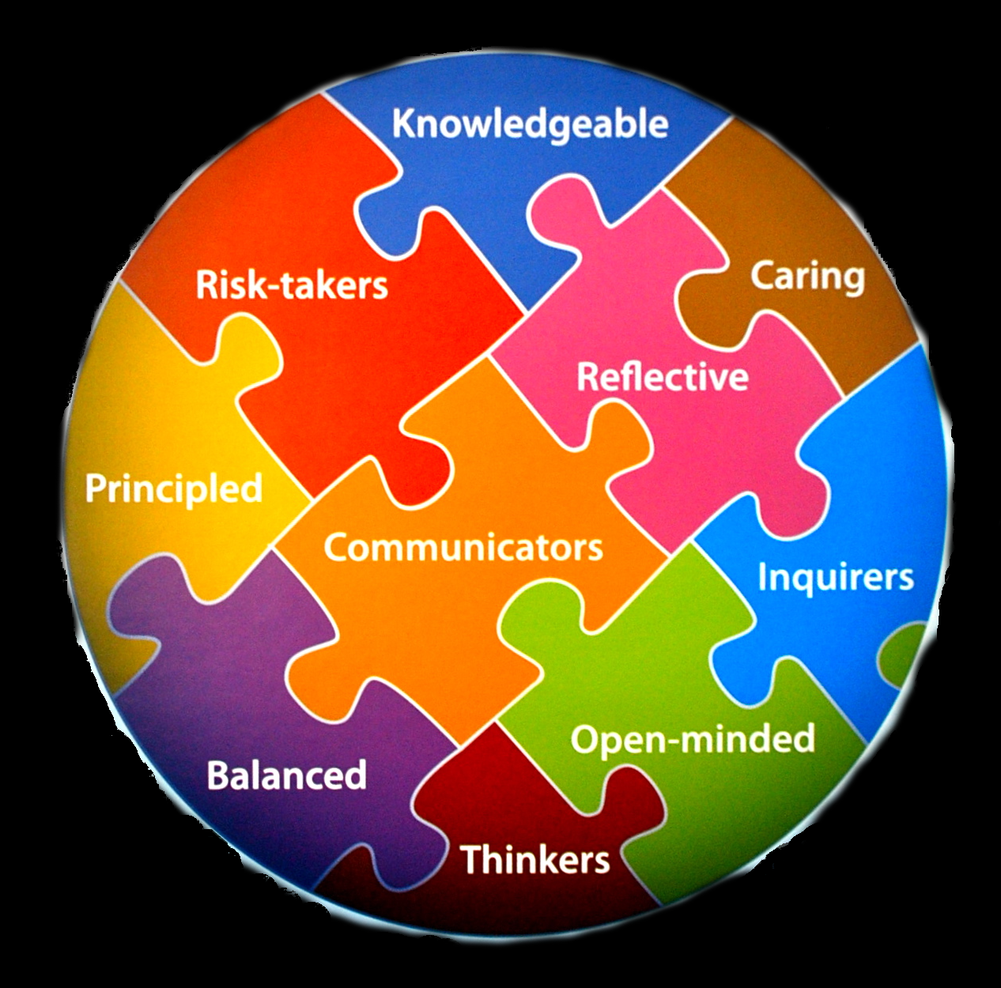

Slide 5
No “specialty” in our Center
Students receive a “classical, liberal arts” education
Focus on six areas of educational endeavor: English, world language, history, experimental sciences, mathematics, and the arts
Balanced curriculum in breadth and depth
Students explore how to learn and how their learning relates to life through Global Contexts in all classes in MYP, in Theory of Knowledge class and topics in the Diploma Program, and in the application of knowledge in service to the community

Slide 6
Quality Control
Internal standardization of MYP assessments in Grade 10
Moderation of the personal project
Moderation of internal assessments in grades 11 and 12
Externally scored IB exams

Slide 7
IB & AP
Authorization process to become designated as an IB World School
Program must be accredited
International standard
No formal process to teach AP
No outside accountability required
National standard

Slide 8
How can IB pay off?
Special programs
College acceptance
Scholarships
Greater confidence
Higher performance in college and beyond

Slide 9
Applications
50 seats at Tucker, 100 at Henrico
May apply to both sites; both sites may or may not accept you. You will decide where you go.
Follow the county deadlines
Pay special attention to the essay—be authentic!

Slide 10
Where can you find out more information?
www.ibo.org – International site
http://blogs.henrico.k12.va.us/henricoib/ “Biddle’s Bytes and Bits”
plbiddle@henrico.k12.va.us
http://blogs.henrico.k12.va.us/emharper/ - “Harper’s Highlights”
emharper@henrico.k12.va.us

