Slide 1
The final countdown plus a look at college life!
Ms. Hunt, IB School Counselor
March 4, 2019

Slide 2
Housekeeping Items
Mid-Year Transcripts
Final Transcript- only send one!

Slide 3
Tips for Surviving college admissions season Brought to you by…

Slide 4
1. Try your best to stay calm.

Slide 5
2. Resist the urge to discuss hypothetical outcomes that are now out of your hands.

Slide 6
3. Ignore over sharers.

Slide 7
4. Manage expectations and keep an open mind. REMEMBER: there's no such thing as one "perfect" school.

Slide 8
5. If things go your way, be respectful of those who follow you.

Slide 9
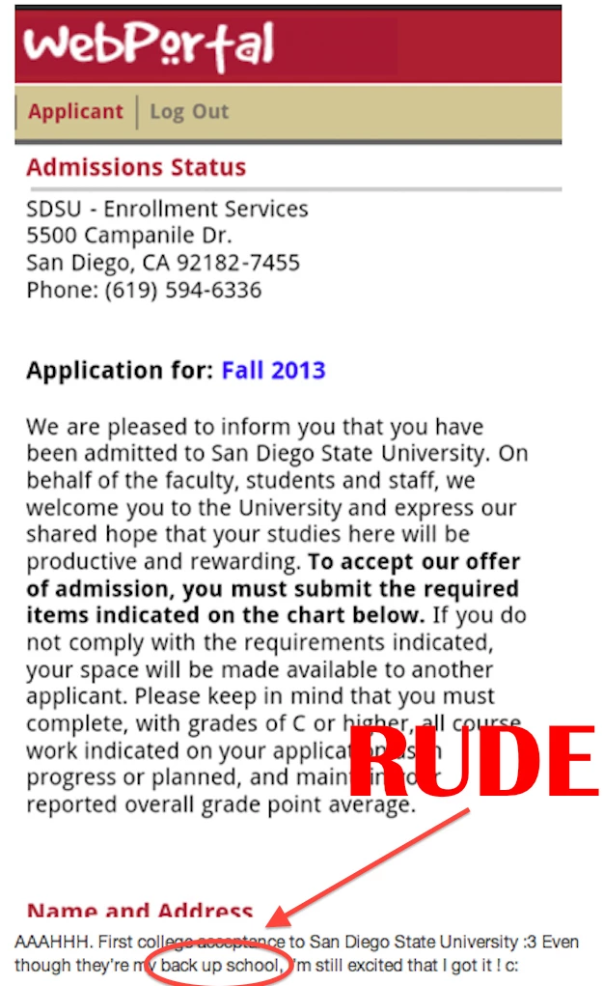
6. Keep in mind that one man's safety school is another man's pipe dream. Be considerate.

Slide 10
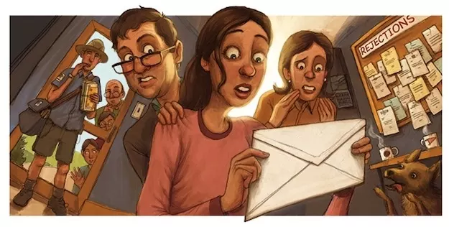
6. No matter how nervous you are, DO NOT ask someone else to open your envelope or admissions email.

Slide 11
7. Avoid learning the news in the company of too many spectators.

Slide 12
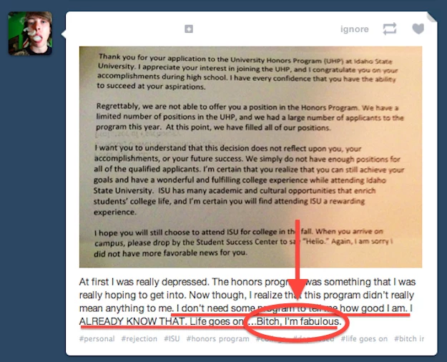
8. Keep perspective: college admissions are NOT a referendum on your worth as a human being.

Slide 13
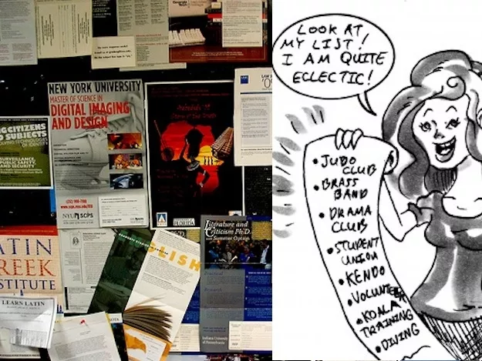
9. If you don't get into your top choice school, focus on the awesome things your other school options offer.

Slide 14
10. After good news and bad, be there for your friends.

Slide 15
11. Focus on the present! Relish these last few breaths of childhood.

Slide 16
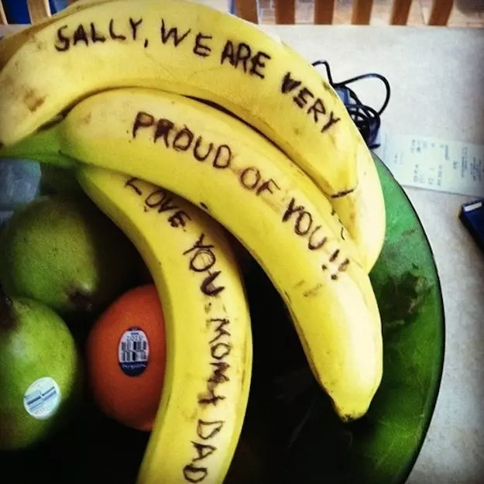
12. Remember that everyone is proud of you. Believe them. Enjoy your accomplishments.

Slide 17
13. Even if you're disappointed, remember that getting into college is just one of the many situations in life where you have limited control.

Slide 18
14. And remember that no matter where you go, college can be awesome!

Slide 20
Joining clubs & organizations!
What are you passionate about?
Look for organizations within your major.
Go Greek.
Go to a student government meeting.
Attend the “cheesy” events for freshman.
Join an intramural sports team.
Check social media.

Slide 21
Conversations to have with your new roommate…
Get to know one another.
Who is bringing what items?
Set ground rules.
Discuss studying and sleeping habits.
Identify personal and shared space.

Slide 22
How would you handle this situation?
Get in small groups. Read over the roommate scenarios and be prepared to share your responses!

Slide 23
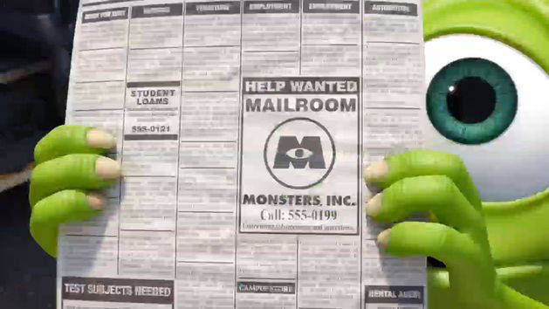
The real world: budgeting
Have you considered your source of income during college?
Have you talked with your family about finances in college?
How can you ensure that you are ready to deal with surprise situations?
What do you need to do to make sure you are financially set for next year?
Think about ways in which you could work and further your career/degree.

Slide 24
Feelings about taking the next step!
What makes you nervous about college?
What makes you excited about college?

Slide 25
What I wish I had known for Senior Year
https://tinyurl.com/senioryearfeedback

